Slide 1
Big Data Analysis
Presented
by
Sakthidevi T

Slide 2
Pre - Requisite
Java Essentials
Construct
File handling
String Handling
Generics and Collections
Exception handling

Slide 3
continue…
SQL
Basic queries (create, retrieve, insert, join)
J2EE Essentials
Introduction Web Application
Servlets and JSP

Slide 4
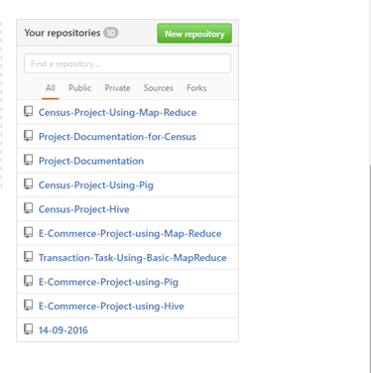
Github

Slide 5
Big Data
Big Data is similarly a data but bigger in size. Its generates value from the storage and processing of very large quantities of digital information that cannot be analyzed with traditional computing techniques.
Characteristic of Big Data
Volume
Velocity
Variety
Veracity

Slide 6
So What do we do?
The obvious solution is that we use multiple processors to solve the same problem by fragmenting it into pieces.
Imagine if we had 100 drives, each holding one hundred of data. Working in parallel, we could reach the data under two minutes.
The key issues involved in distributed computing
Hardware failure
Combining the data after analysis
Network associated problems

Slide 7
Hadoop
Apache Hadoop is an open source framework for running applications on large cluster built of commodity hardware.
A common way of avoiding data loss is through replication. Redundant copies of the data are kept by the system so that we can have another copy of data.
The next problem is solved by a simple programming model called “MapReduce”. It is a powerful technology designed for deep analysis and transformation of huge data sets.

Slide 8
Hadoop Eco System s
There are various tools in hadoop eco systems
Pig
Hive
Sqoop
Flume
Hbase
Zookeeper
Oozie

Slide 9
Technology used
Map Reduce / Advance Map Reduce
Pig
Hive
Sqoop

Slide 10
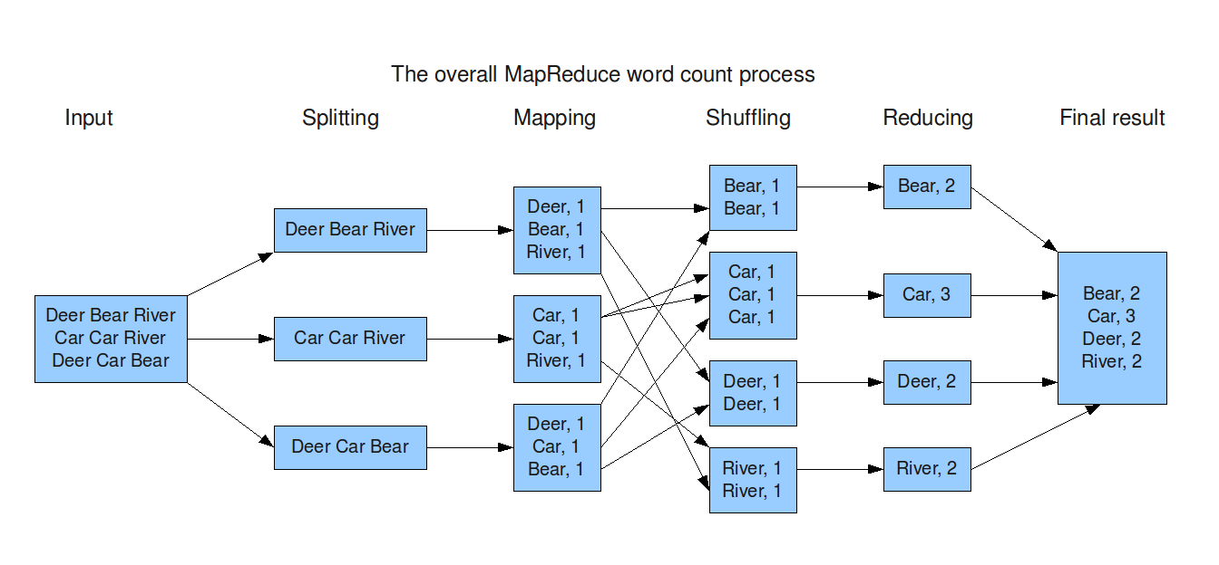
Map Reduce

Slide 11
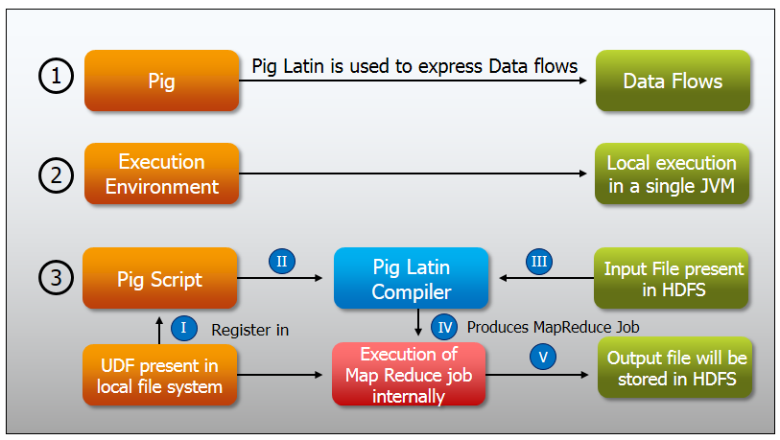
Pig

Slide 12
Hive
Hive gives an SQL-like interface to query data stored in various databases and file systems that integrate with Hadoop. The traditional SQL queries must be implemented in the Map Reduce Java API to execute SQL applications and queries over a distributed data.

Slide 13
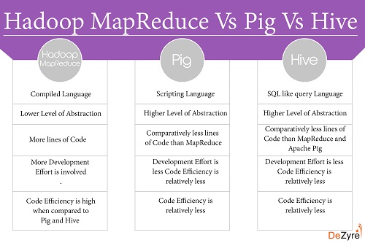
Difference between MR, Pig and Hive

Slide 14
Knowing Your Customer Requirement in E-Commerce (KYCRE)

Slide 15
Objective
This project is to develop a general analysis on e-commerce store where sports product .
This applications support the interaction between different parties participating in a commerce transaction via the network, as well as the management of the data involved in the process.

Slide 16
Scope
The scope of the process is to analyze the requirement of the customer in terms of transaction, category, product, payment mode, city etc.
The outcome of this analysis will lead the organization to satisfy the customer as well as in economic benefit.

Slide 17
Requirement Specification
Transactional data which contains transaction details of each customer (such as transaction id, transaction amount, customer id, payment mode, transaction place, transaction date etc.)
Customer data which contains the details of customer (such as customer id, first name, last name, professional and age).

Slide 18
Use cases
Sales Report
Gift card
Honor and Waiver
Payment mode

Slide 19
Analysis on Census Data

Slide 20
Objective
The objective of this project is to rely on data for decision-making and promote civic engagement: state and local governments; social service agencies; planners; foundations; and, child and family welfare, education, and other vital services.

Slide 21
Scope
The scope of this project is to make wealth and health country.

Slide 22
Requirement Specifications
Census data which contains details of people (such as age, education, marital status, gender, income, tax filler, parents, country of birth, citizen, work etc.)
Age group data which contains the details of age (such as age, and category)
Secondary table for Tax analysis, Pension and Scholarship

Slide 23
Use cases
Education and Employment
Tax and Income
Welfare and Budget
Population and Immigration
Future Plan
Healthcare camp (Extras)

Slide 24
Conclusion
Since we are dealing with huge data in E-Commerce and Census implemented these project in Hadoop

